Slide 1
Welcome to Year 4
Miss Davies (Emerald Class) Miss Wood (Ruby Class)
Miss Gourlay (Onyx Class)
Support staff in the year group – Mrs Nelson, Mrs Furniss, Miss Downs, Mrs Steyn

Slide 2
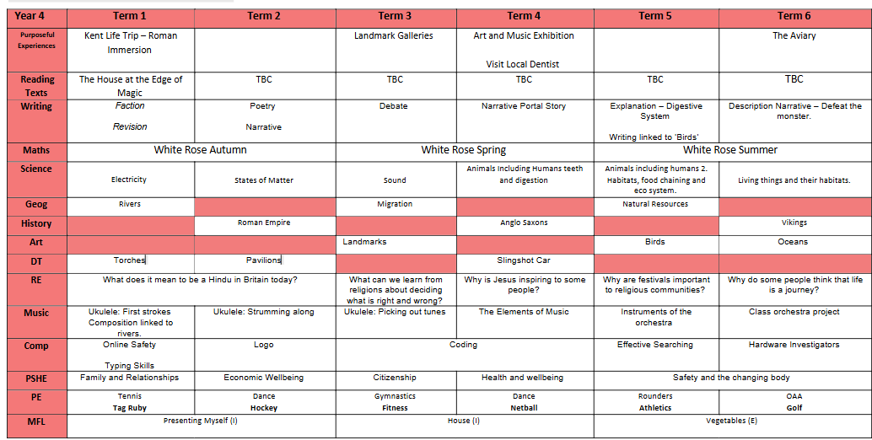
Curriculum Overview – Subject to change

Slide 3

P.E
P.E will be twice a week.
P.E kits must be left at school in case children participate in other activities such as the Daily Mile.
A reminder that jewellery is not permitted during P.E lessons.
Children must be able to take out their earrings or be provided with tape and the appropriate permission slip returned to school
Shoe laces

Slide 4


MTC Check
The Multiplication Tables Check (MTC) is a statutory KS2 assessment which tests Year 4 pupils' knowledge of the multiplication tables within 12 × 12.
The MTC is in the format of an online test with 25 questions similar to TTRS. Children are given six seconds to answer each of the questions within the time limit.
By the end of Year 4, children should know all the multiplication facts within the 1 to 12 times tables.
Monday 1st June - Friday 12th June 2026

Slide 5



Equipment
P.E kits must remain in school at all times.
Sensible sized pencil cases should fit neatly into trays.
House at the Edge of Magic book – not essential

Slide 6
Home learning expectations
Reading: 20 minutes every day
This year we’ve chosen engaging texts to inspire the children’s imaginations and nurture a love of reading.
To support this, it is essential that all children read for 20 minutes each day at home. This regular practice is key to building their confidence, fluency, and understanding.
Maths: Alternate days
TTRS - every day for 10 minutes.
TTRS Heatmaps are sent home regularly so you can see what times tables require more practice.
Spelling: Alternate days
Spellings will be on Spelling Shed – practice every day for 10 minutes.

Slide 7



Thank you for listening!
Do you have any questions?

